Slide 1
Support Vector Machine (SVM)
Dr. Rani Oomman Panicker
Assistant Professor
Department of CSE

Slide 2
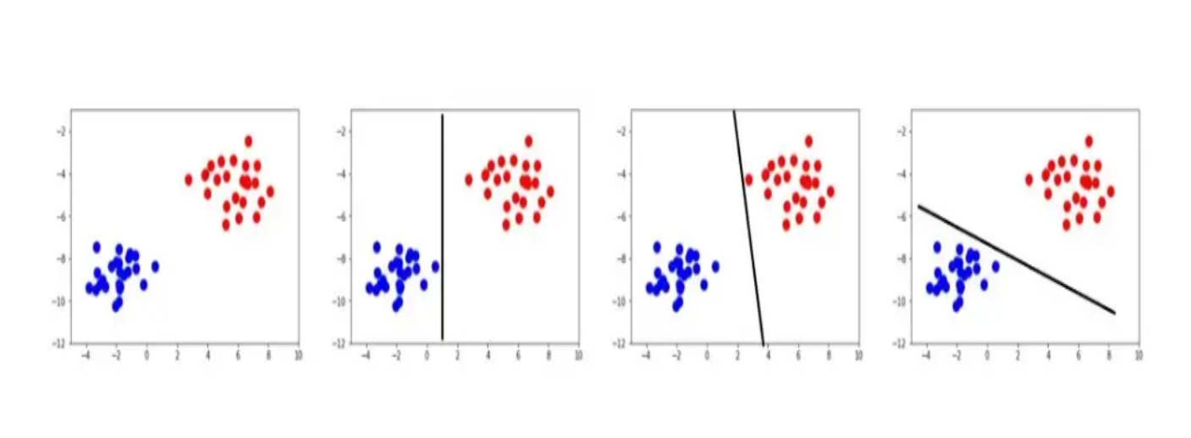
What is Support Vector Machine?
Support Vector Machine” (SVM) is a most popular supervised machine learning algorithm which can be used for both classification and regression challenges.
Primarily, it is mostly used for classification problems.
Fig a
Fig b
Fig c
Fig d

Slide 3
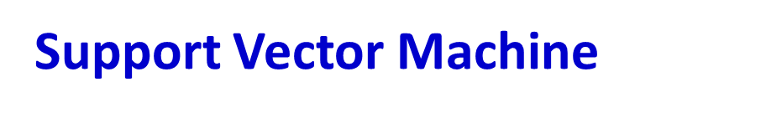
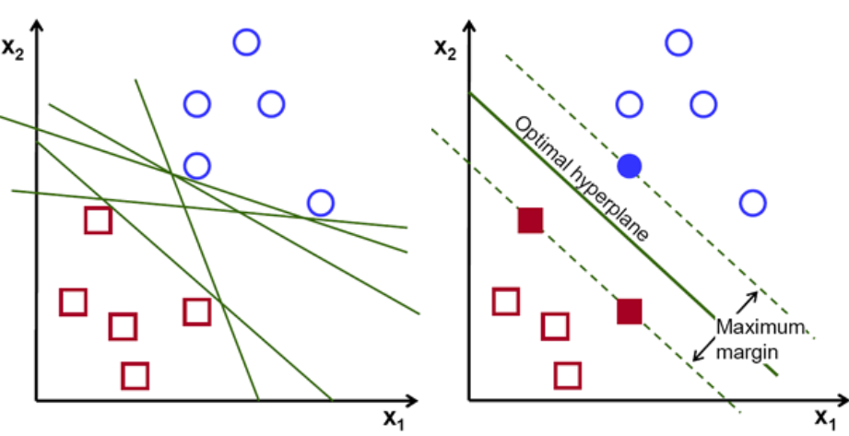
Basic idea is to find the hyper-plane that differentiate the two classes very well.
Positive class
Negative class
Fig. b
Fig. a
Goal is to design a good hyperplane

Slide 4

In two dimensional space this hyper plane is a line dividing a plane in two parts where in each class lay in either side.
The beauty of SVM is that if the data is linearly separable.

Slide 5
Fig. a
Fig. b
The core of SVMs consist of a maximal margin hyperplane (also referred to as the decision boundary)
Maximum margin is for predictable performance on unseen data.

Slide 6
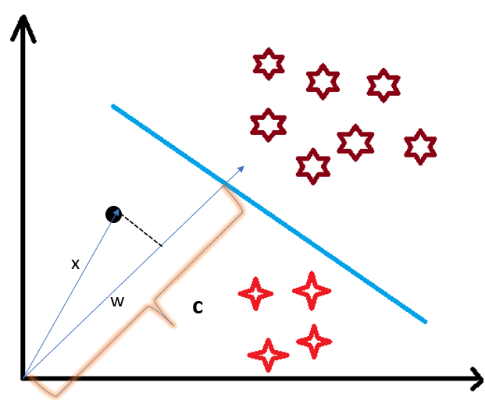
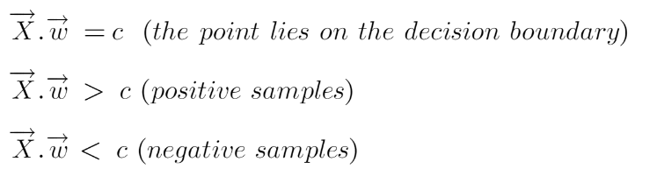
assume this point is a vector (X) vector (w) which is perpendicular to the hyperplane. Let’s say the distance of vector w from origin to decision boundary is ‘c’. Now we take the projection of X vector on w.

Slide 7
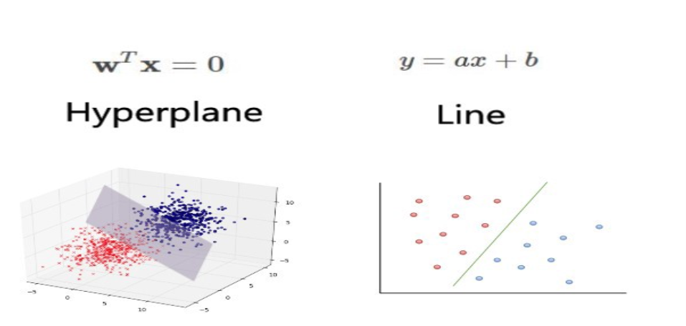
2-dimensional graph we call this decision boundary a straight line but if we have more dimensions, we call this decision boundary a “hyperplane”
What is Support vectors?
The vectors (cases) that define the hyperplane are the support vectors.
Support vectors are points that touching the margin.

Slide 10
Role of margin in SVM
The distance between the hyperplane and the nearest data point from either side is known as the margin.
The goal is to choose a hyperplane with the greatest possible margin between the hyperplane and any point within the training set, giving a greater chance of new data being classified correctly.
Maximize the margin and minimize the miss classification.

Slide 11
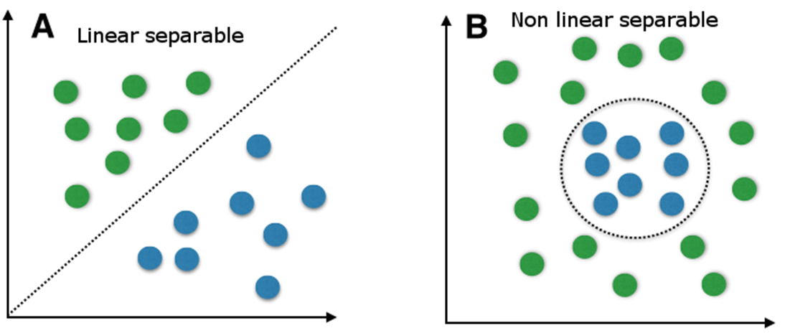
Support Vector Machine-- Types
Linear SVM classifier
Non-linear SVM classifier
Linear
Non-linear

Slide 12
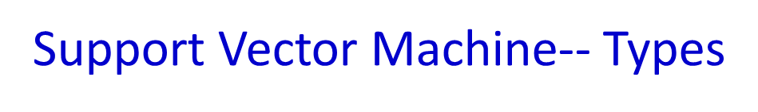
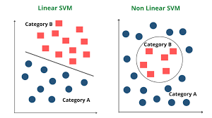
Linear SVM Classifier
It predicts a straight hyper plane dividing 2 classes.
The primary focus while drawing the hyper plane is on maximizing the distance from hyper plane to the nearest data point of either class.
The drawn hyperplane called as a maximum-margin hyperplane.
2. Non-Linear SVM Classifier
Non-Linear Classifiers by applying the kernel trick to maximum-margin hyperplanes.
In Non-Linear SVM Classification, data points plotted in a higher dimensional space.

Slide 13
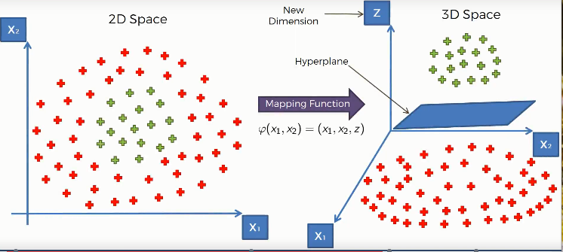
Kernel Trick of SVM
A Kernel Trick is a simple method where a Non Linear data is projected onto a higher dimension space so as to make it easier to classify the data where it could be linearly divided by a plane.

Slide 14
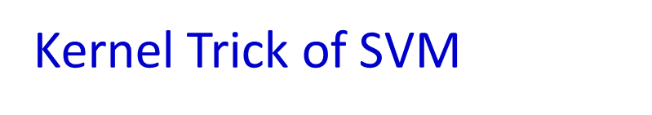


Slide 15
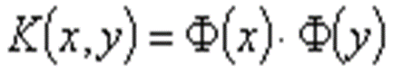
SVM kernels helps to convert the non linear region into linear.
This is called kernel trick which means the kernel function transform the data into a higher dimensional feature space to make it possible to perform the linear separation.
This mapping is defined by the Kernel(K):
Kernel functions merge two steps:
Map input data from input space to feature space(might be infinite dimension).
Do inner product in the feature space.

Slide 16
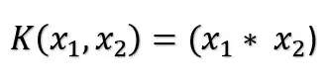
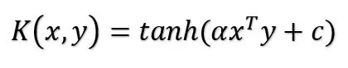
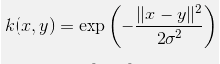
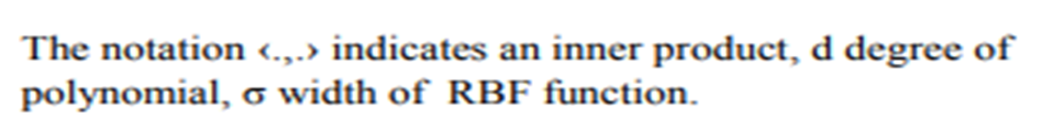

Slide 17
Pros and Cons of SVM
Pros:
It works really well with clear margin of separation
It is effective in high dimensional spaces.
It uses a subset of training points in the decision function (called support vectors), so it is also memory efficient.
Cons:
It doesn’t perform well, when we have large data set because the required training time is higher
It also doesn’t perform very well, when the data set has more noise i.e. target classes are overlapping

Slide 18
Applications of SVM

Slide 19
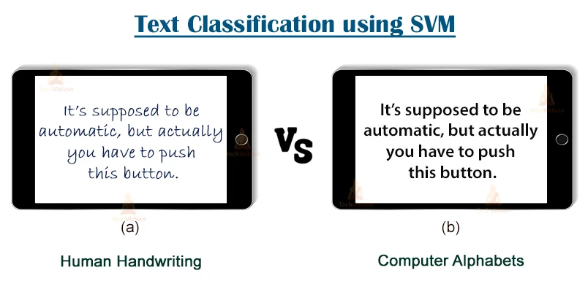
Applications of SVM

Slide 20
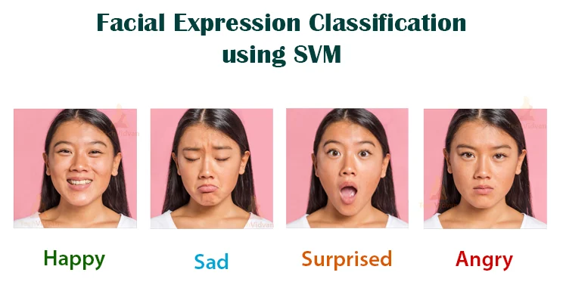
Applications of SVM

Slide 21
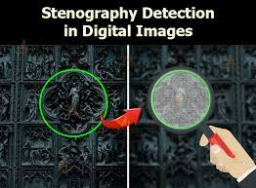
Applications of SVM
An image is pure or adulterated.

Slide 22
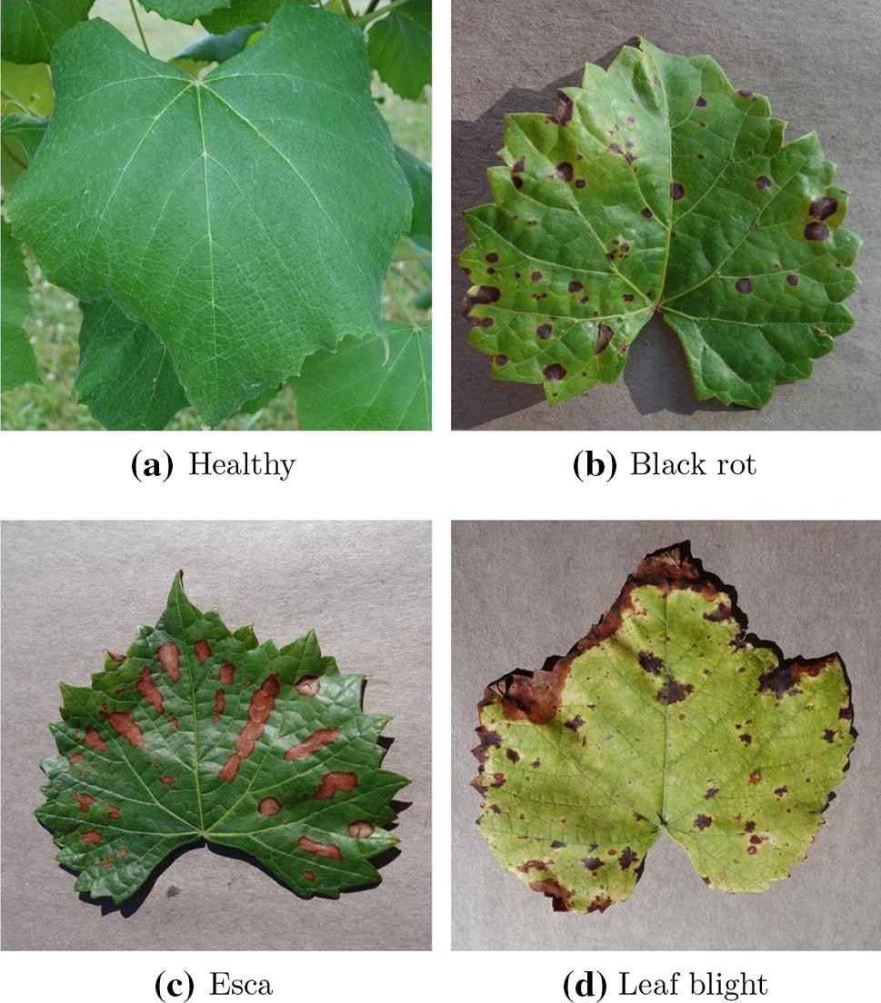
Applications of SVM
Plant disease classification using SVM

Slide 23
Applications of SVM
Skin cancer classification

Slide 24

Applications of SVM
Email classification

Slide 25
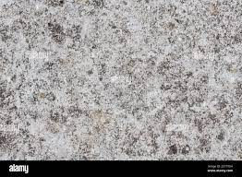
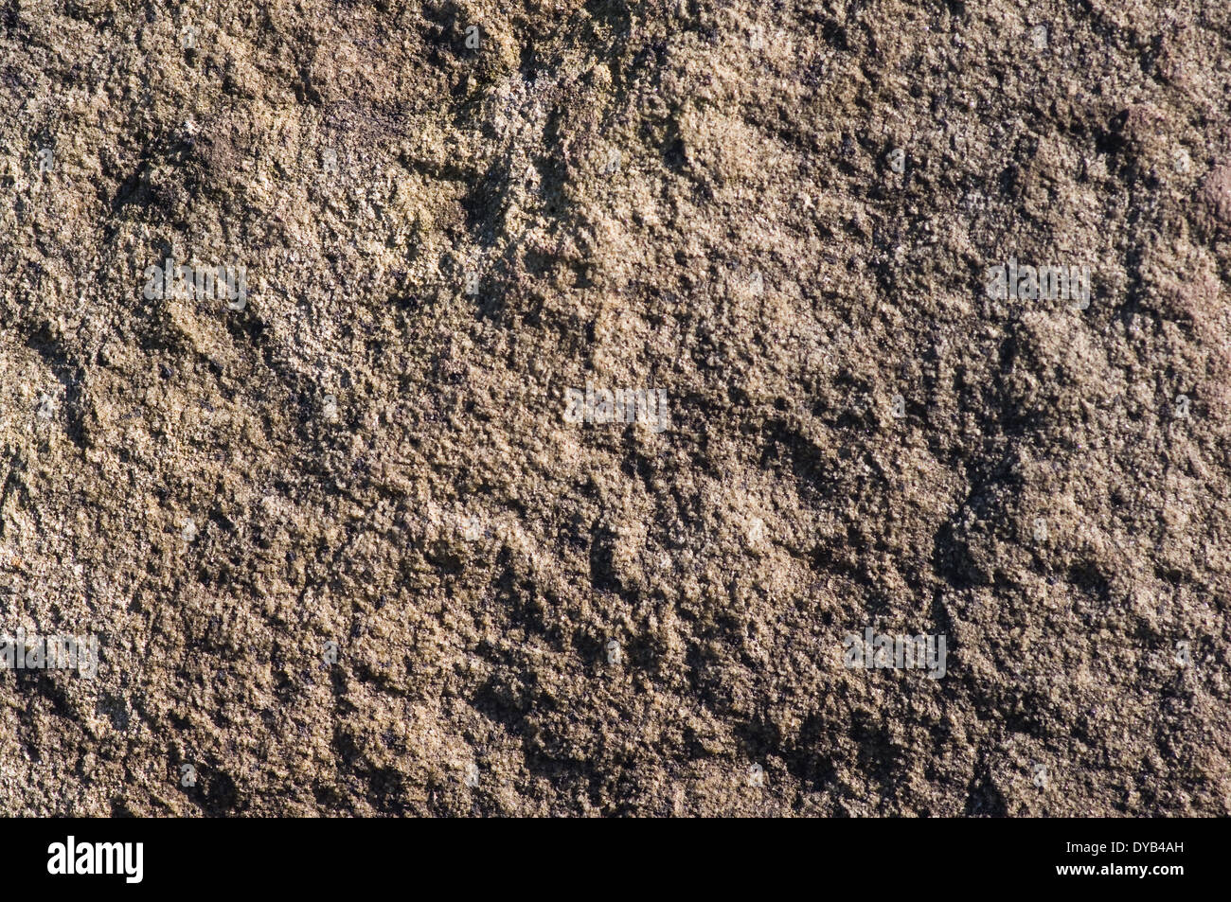
Texture Classification using SVM
Applications of SVM
Smooth surface
Gritty or rough surface

Slide 26
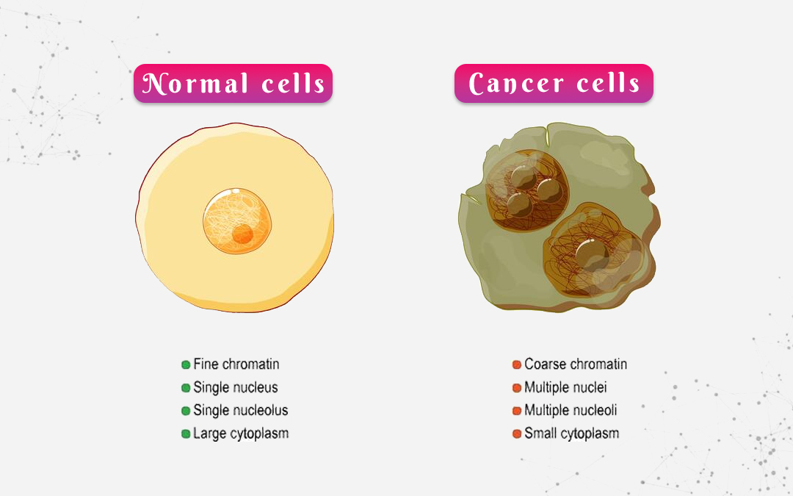
Applications of SVM

Slide 27
Soft margin hyper plane (SVM)

Slide 28
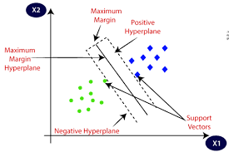
Two types of SVM
1)Hard margin SVM: the algorithm aims to find the hyperplane that separates the classes with the maximum margin while strictly enforcing that all data points are correctly classified.

Slide 29
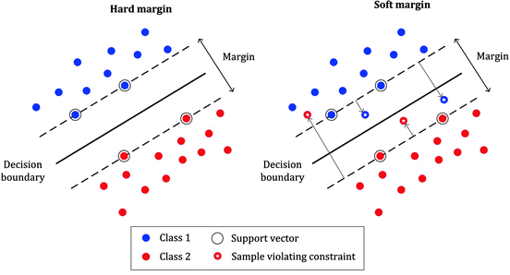
Soft Margin SVM
2) Soft margin SVM: is suitable for cases where the data may not be perfectly separable or contains noise or outliers.

Slide 30
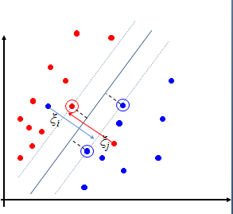
soft margin hyper plane
If the data is not linearly separable, the earlier method(hard margin) will not work.
( ie, data contain outliers or noise measurements)
We define a slack variables ξ_{i,}which store the deviation from the margin.
Noise

Slide 31
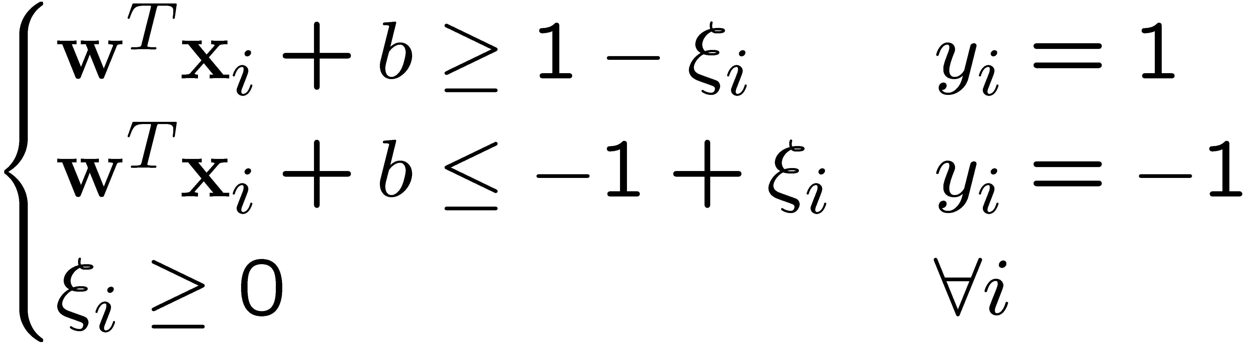
Soft Margin Hyperplane--mathematically
ξ_{i} are just “slack variables” in optimization theory
The variable
ξ allows more flexibility in our model. It has the following interpretations:
1.
𝜉𝑖=0: This means that 𝑋𝑖 is correctly classified and this data point is on the correct side of the hyperplane and away
from the margin.

Slide 32
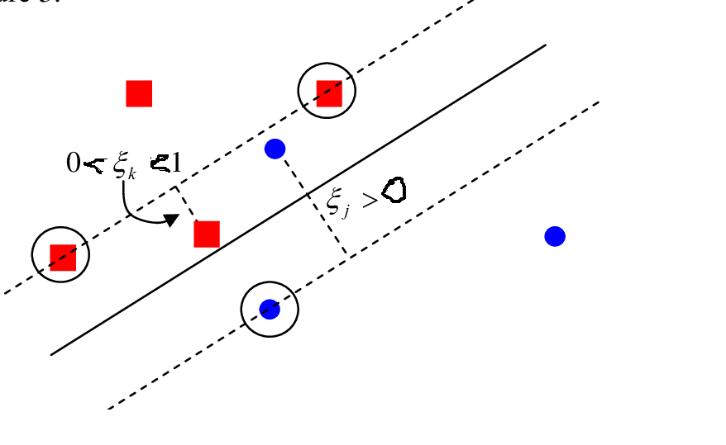
0< 𝜉𝑖<1: When this condition is 𝑋𝑖 lies on the correct side of the hyperplane but inside the margin.
𝜉𝑖>0: Satisfying this condition implies that 𝑋𝑖 is misclassified.

Slide 33
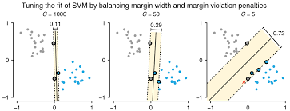
Soft margin SVM, also known as C-SVM (C for the regularization parameter)
As the value of C increases the margin decreases thus Hard SVM.
If the values of C are very small the margin increases thus Soft margin VM.

Slide 34
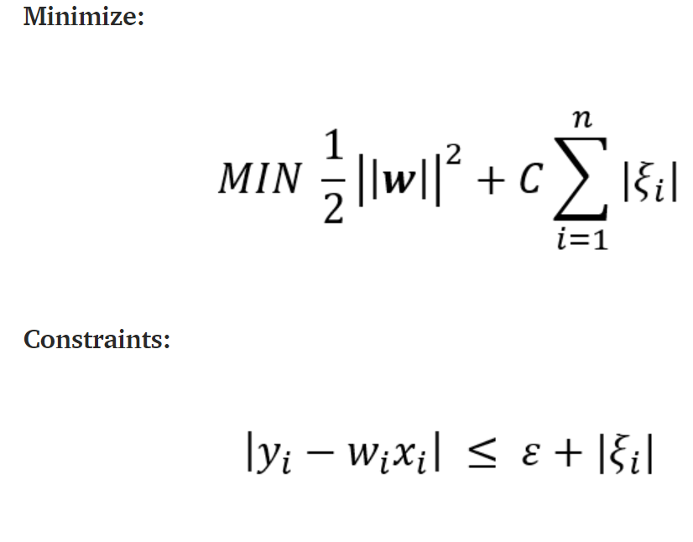
C hyper parameter

Slide 35
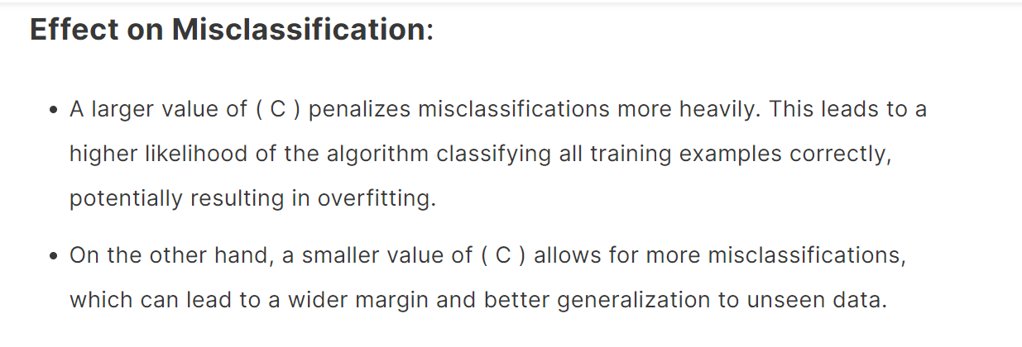

Slide 36
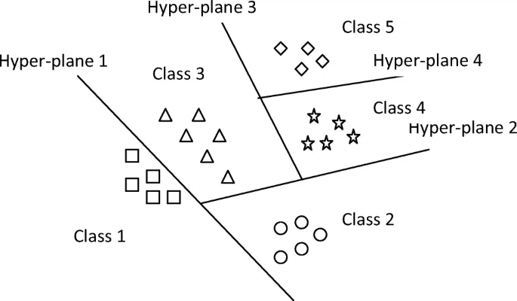
SVM for Multiclass Setup:
Where we have more than two categories in “Output”. SVMs were originally designed for binary classification. When dealing with multiclass problems (more than two classes), there are approaches to extend SVMs, such as
one-vs-one and one-vs-all (or one-vs-rest), which allow SVMs to handle multiple classes by breaking down the problem into binary classification subproblems.

Slide 37
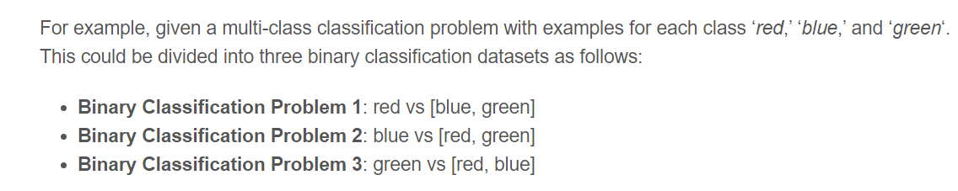
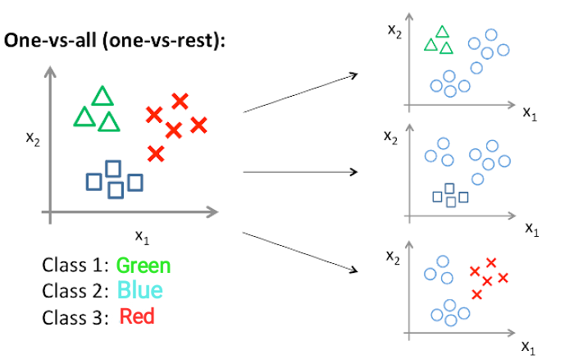
one-vs-all (or one-vs-rest)

Slide 38
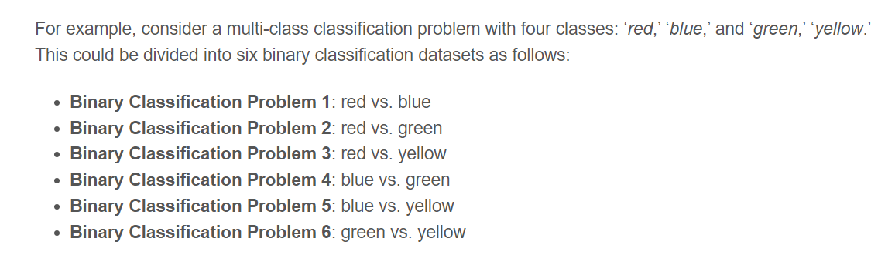
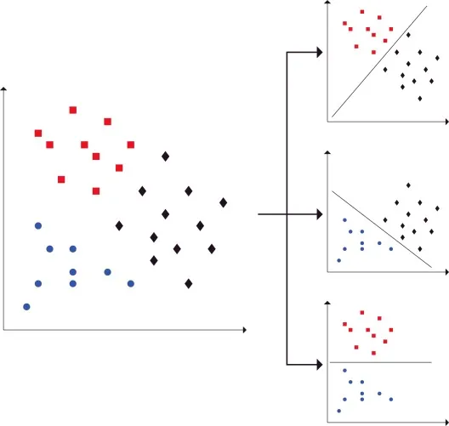
One Vs One

Slide 39
PUBLIC DATASET
diabetes.csv
https://www.kaggle.com/datasets/saurabh00007/diabetescsv?resource=download
Pregnancies
Glucose
BloodPressure
SkinThickness
Insulin
BMI
DiabetesPedigreeFunction
Age
Outcome
8 Features

Slide 40
Diabetes DATASET

Slide 41
code
https://www.section.io/engineering-education/diagnose-diabetes-with-svm/

Slide 47
Testing--SVM

Slide 49
SVM videos
https://www.youtube.com/watch?v=_YPScrckx28

Slide 50


